Slide 1

CMR COLLEGE OF ENGINEERING & TECHNOLOGY
Kandlakoya, Medchal, Hyderabad - 501401
Department of Computer Science and Engineering
COMPARATIVE STUDY OF MACHINE LEARNING ALGORITHMS FOR FRAUD DETECTION IN BLOCKCHAIN
Batch No.:80
Name of the student:
K. Pavan Reddy (20H51A0515)
M. Varun (20H51A0516)
T. Nihith Novah (20H51A0553)
Under esteemed guidance of
Ms.K.Ragini.
(Assistant Professor of CSE)

Slide 2
Outline
Abstract
Introduction
Literature survey
Existing system
- Problems in existing system
Research Objective of Presentation
Problem Definition
Research work
- Proposed system architecture
- Methods
- Comparison of Proposed system with an existing system
Performance Measure
Results
Conclusion
Future Work
References
Notes:
2

Slide 3
Abstract
Notes:
3

Slide 4
ABSTRACT
Fraudulent transactions significantly impact blockchain network trust and the economy.
Traditional consensus methods (e.g., proof of work or proof of stake) can't confirm the identity of participants, leaving the network susceptible to fraud.
Machine learning algorithms offer a potential solution to detect fraudulent transactions and participants.
Fraudulent exchanges in the blockchain economy deter investors and raise skepticism.
This study explores the effectiveness of controlled AI and deep learning models in identifying fraudulent transactions and users, integrating machine learning with blockchain technology.

Slide 5
INTRODUCTION
Notes:
5

Slide 6
Introduction
Detecting fraudulent transactions is a longstanding problem with economic and trust implications in blockchain technology.
Fraudulent transactions deter investment in Bitcoin and other blockchain solutions due to their suspicious nature.
Blockchain network members actively work to identify and prevent fraudulent transactions to maintain community integrity.
Multiple machine learning techniques have been explored, but no clear superior method for fraud detection has emerged yet.
Notes:
6

Slide 7
Literature Survey
Notes:
7

Slide 8
Existing system
1)Synthetic data generation using SMOTE oversamples malicious entities, reducing classification bias. Results, depicted for balanced dataset. Observing log loss during XGBoost training. The small gap between training and test data log loss suggests the model's capability for real-world anomaly detection in blockchain networks.
2) Blockchain technology is a powerful tool for preventing fraud in business networks. It creates an unalterable transaction record, ensures data security, and addresses privacy concerns by anonymizing data and enforcing permission-based access. The consensus process adds an extra layer of validation before transactions are added to the blockchain.
3)Preprocessing and Data Handling.
Model Building and Evaluation: Various machine learning and deep learning techniques are employed to predict transaction success. Models are evaluated using bootstrapping to estimate parameters and determine efficacy based on mean accuracy values.
Notes:
8

Slide 9
Research Objective
Notes:
9

Slide 10
Research objective
Our research objective is to compare the performance of various supervised machine learning models like SVM, Decision Tree, Naive Bayes, Logistic Regression, and few deep learning models in detecting fraudulent transactions in a blockchain network.
Such comparative study will help decide the best algorithm based on accuracy and computational speed trade-off.

Slide 11
Problem Definition
Notes:
11

Slide 12
Problem Definition
The challenge of detecting fraudulent transactions in blockchain networks has long-lasting negative consequences for the economy and trust in cryptocurrencies and blockchain solutions.
This study conducts a comparative analysis of supervised machine learning and deep learning models, including SVM, Decision Trees, Naive Bayes etc. to determine the most effective fraud detection algorithm.
The primary objective is to identify which algorithm is showing best accuracy.

Slide 13
Research Work
Notes:
13

Slide 14
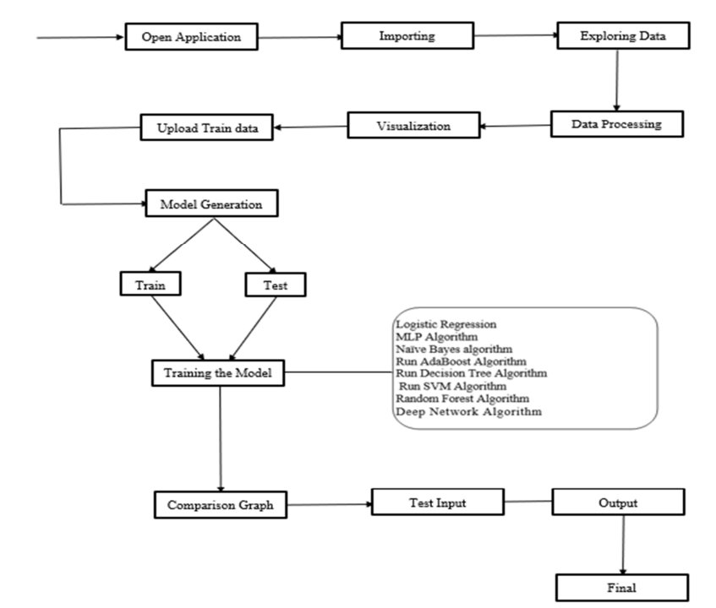
Proposed system architecture

Slide 15
Proposed Methods
The proposed system model consists of two layers: blockchain and machine learning. The blockchain model initiates transactions, and then machine learning models are used to classify these transactions as malicious or legitimate. This is a binary classification.
The proposed system model is based on the integration of machine learning and blockchain for fraud and anomaly detection in the financial sector. The anomaly detection system identifies unusual suspicious events that are different from most of the data.
A dataset of bitcoin transactions is used for the proposed model.
We also use the random forest, use Convolution Neural Network (CNN) deep learning coupled with summarizes the method for identifying fraudulent activities and XGboost classifiers to classify legitimate and malicious transactions. These classifiers are also used to predict new incoming transactions. The proposed model is trained and tested for legitimate and malicious data patterns using the given dataset.

Slide 16
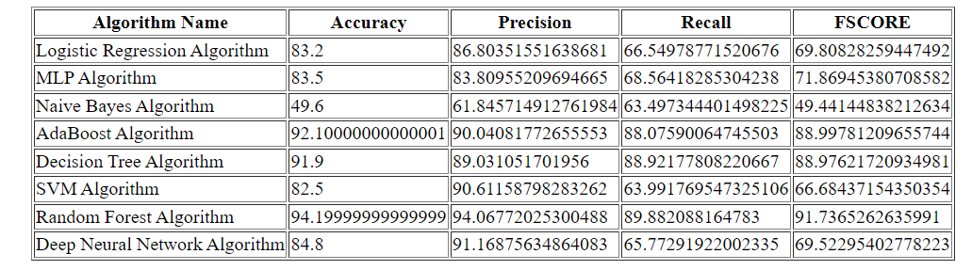
Performance Measure:

Slide 17
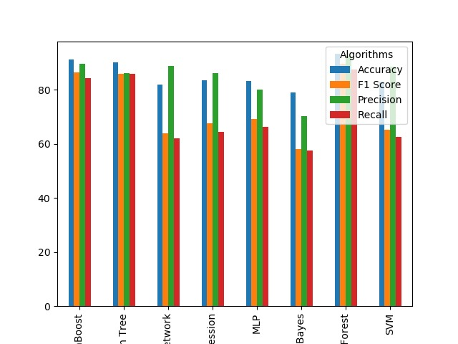
Result Analysis
Comparison Algorithm:
This Graph interprets the data of the comparison of the accuracy, precision, recall and f-score of Logistic Regression, MLP, Naïve Bayes, AdaBoost, Decision Tree, SVM, Random Forest and Deep Neural Network.

Slide 18
Conclusion
A study explored the use of machine learning to detect fraudulent transactions within a blockchain network.
The researchers examined various supervised learning algorithms like support vector machines, decision trees, logistic regression, and dense neural networks, comparing their performance in terms of accuracy.

Slide 19
Future work
They suggested extending the study to include unsupervised techniques such as clustering. Additionally, the researchers expressed intentions to conduct a detailed investigation into fraudulent activities within a private blockchain network in the future.

Slide 20
References
[1] Zero-knowledge proof-of-identity: Sybil-resistant, anonymous authentication on permissionless blockchains and incentive compatible, strictly dominant …DC Sánchez - arXiv preprint arXiv:1905.09093, 2019 - arxiv.org
[2] Ensuring consensus on trust issues in capability-limited node networks with Blockchain technology S Hadjiefthymiades, M Chatzidakis, D Reisis - pergamos.lib.uoa.gr
[3] Comparative study on identity management methods using blockchain AG Nabi - University of Zurich, 2017 - files.ifi.uzh.ch
[4] The blockchain and the new architecture of trust K Werbach - 2018 - books.google.com
[5] Effectiveness of Machine and Deep Learning for Blockchain Technology in Fraud Detection and Prevention Y Kumar, S Gupta - Applications of Artificial Intelligence, Big Data …, 2022 - taylorfrancis.com
[6] Financial fraud detection applying data mining techniques: A comprehensive review from 2009 to 2019 KG Al-Hashedi, P Magalingam - Computer Science Review, 2021 – Elsevier
[7] Analyzing Various Machine Learning Algorithms for Blockchain-Based Fraud Detection S Giribabu, V Sriharsha, PH Basha… - … Research in …, 2022 - acspublisher.com

Slide 21
Thank You!

